Slide 1

Optimising Healthcare Resource Allocation Through Patient Treatment List Consolidation
Aims:
Significantly reduce wait times and optimise resource utilisation.
Shifting triage to an NHS-wide level and evaluating its impact.
Develop a scalable, data-driven framework for consolidating Patient Treatment Lists (PTLs) across providers to support future NHS integrated care initiatives.
Reduce cost of the operations

Slide 2
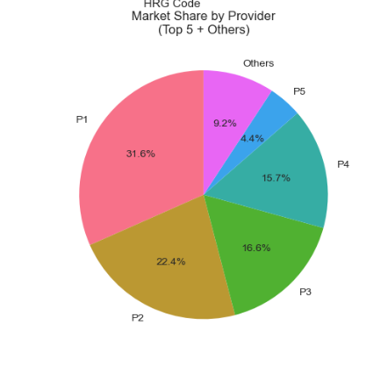



Mathematical Modelling with Queueing Theory
Modelling Patient Flow
Quantifying Impact
NHS-Level Triage
We analyse patient queues like supermarket lines, comparing individual hospital queues against a single, shared PTL.
Formulas calculate precise wait times and resource usage, offering insights into system efficiency.
Centralised triage ensures optimal patient routing, directing them to the most appropriate facility swiftly based on complexity and availibility
This phase provides a clear blueprint for how a unified PTL can dramatically reduce delays across the system, much like optimising a checkout system for faster service.

Slide 3
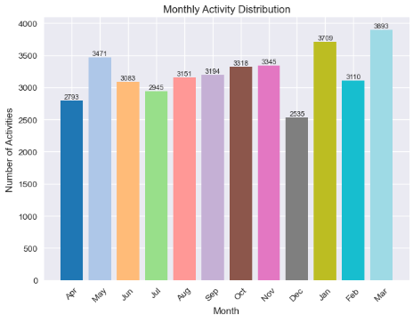
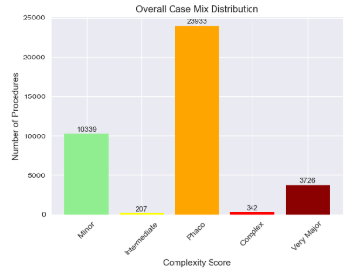
Real-World Simulation for Optimisation
Using Python’s SimPy, we create realistic digital twins of patient journeys from referral to treatment.
This allows us to rigorously test various strategies, such as implementing shared weekend surgeries across multiple hospitals or dynamically rerouting patients to less busy facilities.
This approach is akin to running a video game that tests different hospital configurations and patient flow scenarios.
The primary benefit of NHS-level triage in this phase is to guarantee fairer and faster patient routing
Outcome: Concrete proof of which setups effectively cut patient
wait times and balance workloads across the entire NHS system.

Slide 4



Phase 4: Smart Technology with Machine Learning
Demand Prediction
Optimised Patient Assignment
Enhanced Triage Accuracy
We employ tools like ARIMA and Prophet, similar to weather forecasting, to accurately predict future patient demand and resource needs.
NHS-level triage vastly improves the precision of matching patients with available resources, reducing bottlenecks.
Reinforcement learning is used to assign patients to hospitals, much like a GPS system finding the fastest route, ensuring efficient placement.
This phase culminates in a dynamic, adaptive system that minimises patient wait times by intelligently adjusting to real-time changes in demand and capacity.

Slide 5
Expected Outcomes and
Current State
Key Improvements Anticipated
15-40% better utilisation of staff, beds, and operating rooms.
25-60% shorter patient wait times across all treatment lists.
Fairer access to care across all providers through NHS-level triage.
Reduction of the overall cost based on utilisation, lower cancellations, bulk scheduling and weekend pooling
Current work
Detailed EDA performed to understand the data and find any patterns
Work is ongoing on the simulation for Discrete event simulation
Work is also ongoing in implementing the Queue simulation and creating a base model before we implement the reinforcement learning

